Slide 1

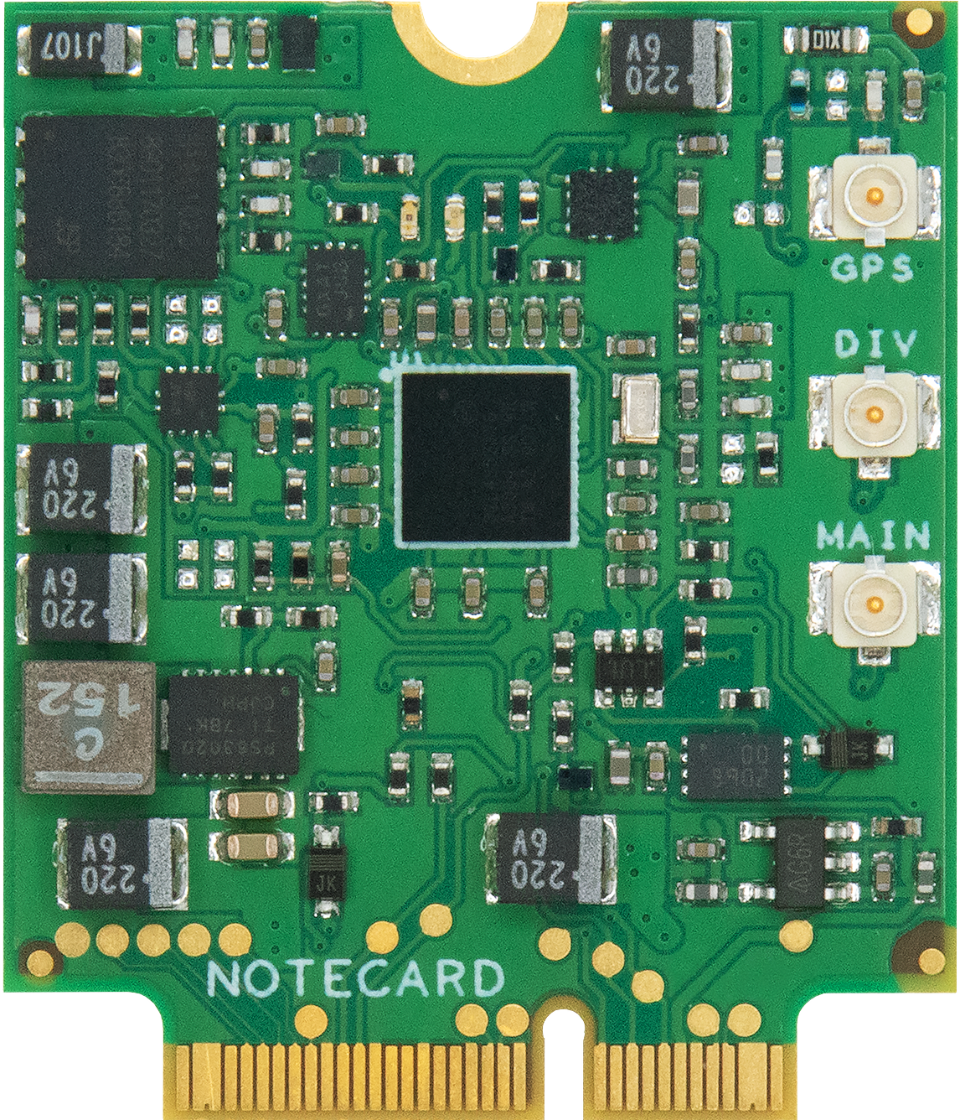
AI, ML, And Deep Learning Demystified

Slide 2

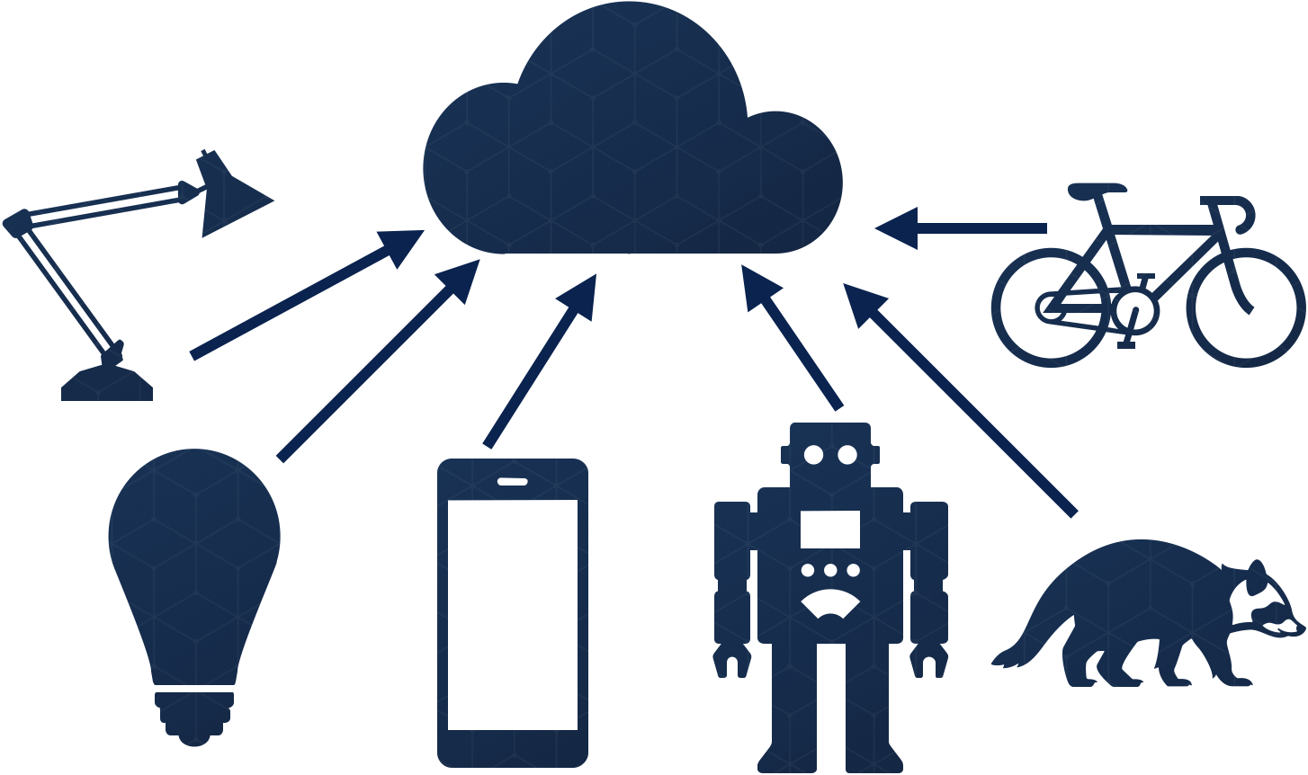
1
2
Data Doesn’t Come From the Cloud
Machine Learning is Human
Notes:
As we kick off our conversation, I want to frame these next two days around two key ideas. Namely, that the data that is so critical to machine learning occurs in the world around us, not in the cloud, which is where much of the attention to ML is focused. And also, that humans play a critical and essential role in making machine learning happen.

Slide 3



Giving Away the Point Up Front
Machine Learning is Human Teaching
Training is Meant for the Cloud
The Real Work of ML is in the IoT
Notes:
So my goal today is to convince you of three things:
Machine Learning is REALLY Human Teaching
Training is meant for the cloud
The Real Work of Machine Learning is happening in the Internet of Things

Slide 4
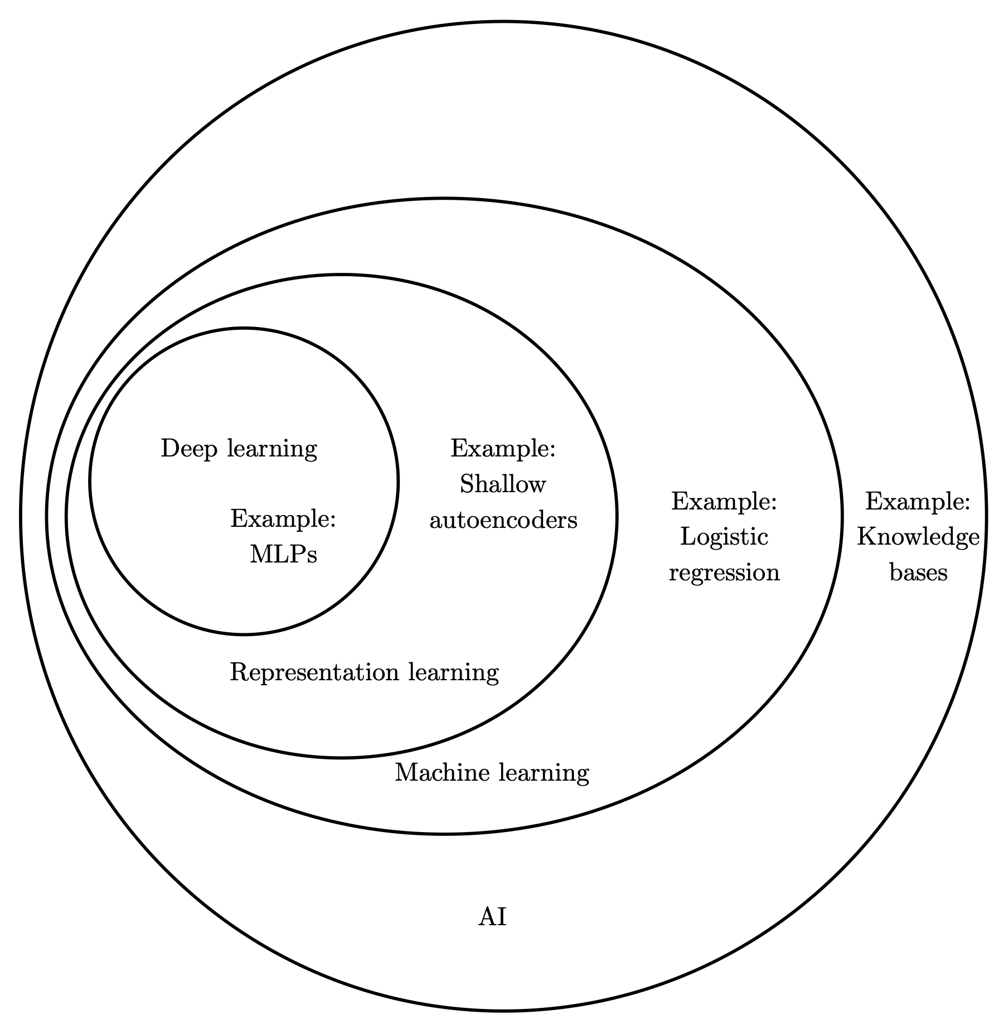
AI, Machine Learning & Deep Learning
Notes:
First, let’s dispense with some terminology, namely AI, ML and Deep Learning. Artificial Intelligence is a broad term, and frankly it's one that has been so overused as to become meaningless, so I am not going to spend much time talking about it here except to say that it's a giant space that encompasses a lot of things, including the fantastical concept of General AI, where machines learn to think for themselves, with no intervention from humans. We’re quite a ways away from that.

Slide 5
Algorithms vs. Predictions
Notes:
Machine Learning is a subset of AI that is focused on training computers to accomplish tasks that would be hard to program algorithms for, either because we don’t know the algorithm, or because it's hard to express easily.
[Slide of a traditional algorithm vs. ML (feed it questions and answers, find the algorithm)]
In traditional programming, we provide an input and an algorithm, and ask the machine to calculate the output.

Slide 6

Algorithms vs. Predicitons
“Learning” Happens Here
Notes:
ML, on the other hand, works differently. In this case, we provide a series of inputs and expected outputs, and we ask the computer to produce the algorithm, which we often call a model.

Slide 7
Machine Learning is Really Human Teaching
Notes:
And even though the domain of Machine Learning puts the computer at the center, I hope it’s obvious from my descriptions thus far that the real work of ML is in the training. And that’s my first takeaway from this talk: ML is really Human Teaching.

Slide 8
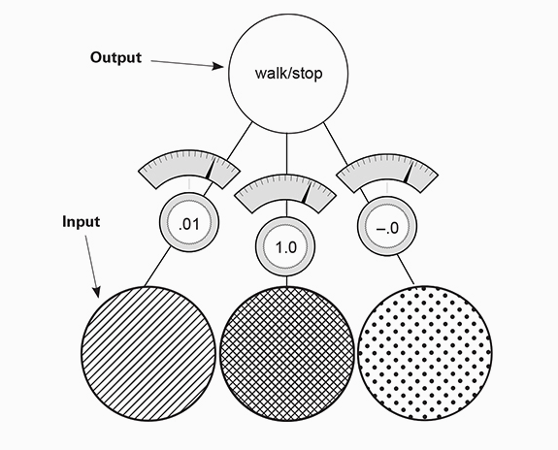
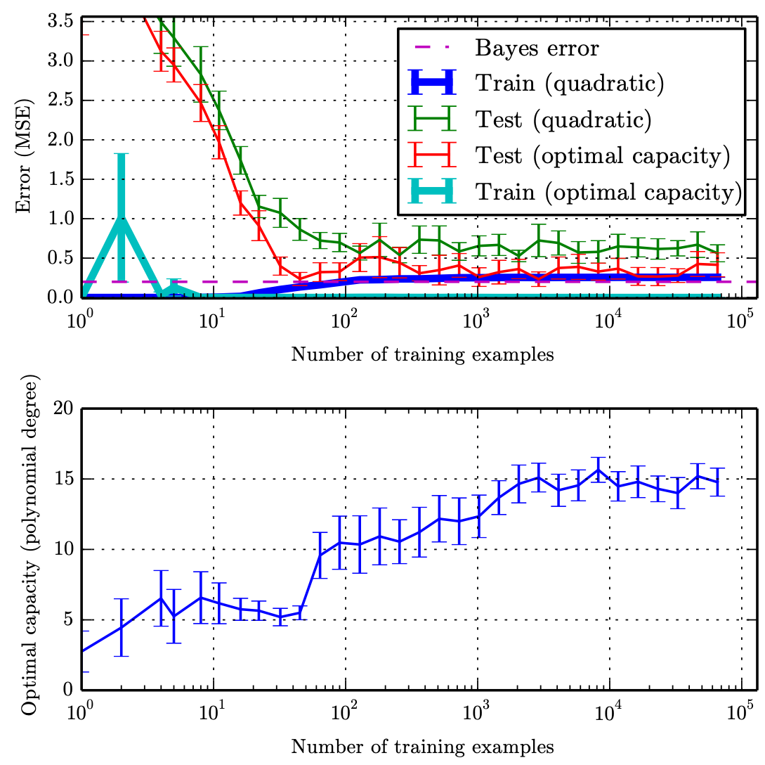
Machine Learning is Human Teaching
1
2
3
Create Inputs and Outputs
Train, Evaluate, Tune
Define a Model Architecture
Notes:
The human is the essential engine of ML, because it takes a human to:
- Create inputs and outputs (data preparation) for the model
- Select a model architecture
Train, evaluate the tune the model
This is an important principle, and one will come back to, because in the realm of ML, we’ve spilled a lot of ink about the importance of these powerful computers with superhuman abilities, when the real critical drivers in taking ML to where it is today is in the humans who have built the architectures, models, principles and research that are the foundation of everything else.

Slide 9
Giving Away the Point Up Front
Machine Learning is Human Teaching
Training is Meant for the Cloud
The Real Work of ML is in the IoT
Notes:
Now that we’ve established the importance of the human in the Machine Learning process, and demystified some terminology, let's talk about the cloud. But first, let’s talk about some of the key phases of the Machine Learning process.

Slide 10
Machine Learning isn’t “done” in any one place
Notes:
I hinted at this already, but it's important to be explicit about it here, because it will frame the rest of our discussion. DOING ML isn’t the domain of giant cloud-based computers that the major providers buried under the ocean. The reason is because the practice of ML can really be broken into three discrete parts:

Slide 11



ML = Development, Training, Inference
1
2
3
Development
Training
Inference
Notes:
[Modeling, Training, tuning, predicting]
Creation (including selection or construction)
Training
Inference
The creation step is the work of the Data Scientist, and it includes the selection of a data set, and data preparation work needed to get the data into the right place for training. This also includes selection of a pre-built model for use or transfer learning, or deciding on the architecture of a new model, if needed.

Slide 12
Model Creation Tools
Notes:
Much of the work at this step takes place on the machine of a developer or data scientist, where tools like PyTorch, Scikit-learn, Numpy, Keras and TensorFlow are often leveraged.

Slide 13
Training, Experiments, & Tuning
Notes:
Once a model is created or selected, the next key step is model training. This is the process of running the input data through the model architecture and its many layers thousands and thousands of times as the machine attempts to find a correlation between the inputs and outputs such that the error of the model approaches zero. This is often the most time-consuming part of ML, and the part that requires powerful servers, or the cloud to run. It’s here that using GPUs, FPGAs and custom cloud-based hardware can help us train models in minutes or hours, instead of running those on our development machines, where they may take days, or longer. The tools in this space are things like Google’s CoLab and Jupyter Notebooks, or using a cloud service like Azure ML to run experiments and refine results.

Slide 14
Training an Emotion Model
Demo
Notes:
[Training an Emotion Model with TensorFlow and Keras in Python]
Let’s look at an example of the model building and training process now.

Slide 15




The Train, Predict, Tune Loop
Define Task
Collect Data
Maintain, Update & Refine
Prepare Data
Explore
Model
Tune
& Refine
Train Model
Test & Evaluate
Deploy Model
Notes:
It’s important to note here that the modeling and training process is often an iterative loop. A model is built, trained, and then we test and refine it. This can happen many times before a model is deployed into production for the final step.

Slide 16


Inference: Prediction in Real time
During training, the network “learns” by tuning weights to reduce error
These weights are then applied against data the network has never seen before to make a prediction
Notes:
Finally, there is prediction, often called inference. This is the reason we create models to begin with, so that we can feed some kind of input that the machine was NOT trained with, and get a reliable result. With inference, we typically load the trained model, provide a new input, and then ask for a prediction or result. Common tools used for inference are Keras, Tensorflow, OpenCV, and the like.

Slide 17
Running Inference on a Model
Demo
Notes:
Let’s run inference on the trained model I showed off a bit ago, using the selfie I grabbed earlier

Slide 18
https://github.com/blues/ml-and-iot-workshop

